Slide 1
Line Drawing Algorithms

Slide 2
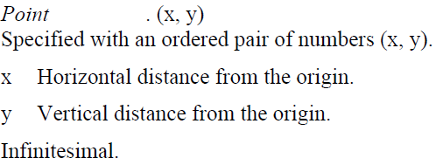
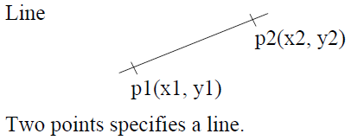
Points and Lines
Dr. DSR Murthy
Unit II: Output Primitives
1
Notes:
1

Slide 3
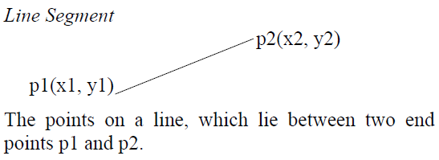
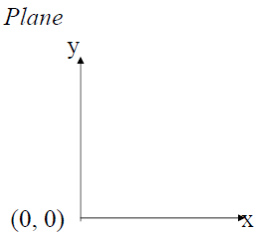
Points and Lines
Dr. DSR Murthy
Unit II: Output Primitives
1
Notes:
1

Slide 4
Pixel
Picture element.
Smallest Addressable Screen element.
Each pixel has a Name or Address.
Computer Graphics images are made by
setting the intensity and colour of the pixels
composing the screen.
Display Screen is a Grid or Array of pixels.
The coordinate (i, j) will give the Col. and Row of a Pixel.
Each pixel will be centred at its Coordinates.
Dr. DSR Murthy
Unit II: Output Primitives
1
Notes:
<number>

Slide 5
Resolution
Maximum no. of Distinguishable points, which a line may have,
is a Measure of the Resolution of the Display Device.
Greater the no. of Points,
Higher the Resolution.
Dr. DSR Murthy
Unit II: Output Primitives
1
Notes:
<number>

Slide 6
2D Graphics Pipeline
Clipping
Object
World Coordinates
Applying
world window
Object
subset
window to
viewport
mapping
Simple 2D Drawing Pipeline
Display
Rasterization
Object
Screen coordinates

Slide 7
Four Major Tasks
Four major task for rendering geometric objects
modeling
geometric processing
transformations
clipping
shading
hidden-surface removal
projection
Rasterization (Scan Conversion)
display
Modeling
Geometry
Rasterize
Display
Computer Graphics
1

Slide 8
Scan Conversion
Rasterization or Scan Conversion is defined as the process of representing continuous graphic object as a collection of discrete pixels.
Various graphic objects are
Point
Line
Rectangle, Square
Circle, Ellipse
Sector, Arc
Polygons……
Hardware, Software, Firmware Implementation
Wednesday, February 16, 2022
Computer Graphics
1
Notes:
<number>

Slide 9
Scan Conversion
Scan Conversion is required in order to convert vector data to Raster format for a scan line display device
convert each graphic object to a set of regular pixels.
determine inside/outside areas when filling polygons.
scan-convert curves
Wednesday, February 16, 2022
Computer Graphics
1
Notes:
<number>

Slide 10
Rasterization (Scan Conversion)
Convert high-level geometry description to pixel colors in the frame buffer
Example: given vertex x,y coordinates determine pixel colors to draw line
Two ways to create an image:
Scan existing photograph
Procedurally compute values (rendering)
Viewport Transformation
Rasterization

Slide 11
Rasterization
A fundamental computer graphics function
Determine the pixels’ colors, illuminations, textures, etc.
Implemented by graphics hardware
Rasterization algorithms
Lines
Circles
Triangles
Polygons

Slide 12
Rasterization Operations
Drawing lines on the screen
Manipulating pixel maps (pixmaps): copying, scaling, rotating, etc
Compositing images, defining and modifying regions
Drawing and filling polygons
Previously glBegin(GL_POLYGON), etc
Aliasing and antialiasing methods

Slide 13
Scan Conversion
The scan conversion process is interleaved with other processes to deliver and improve the final image, some of which are not entirely restricted to the discretization of vectors but are involved in generally determining the colour of each pixel in the raster. e.g:
shading & illumination,
hidden surface removal
texture mapping
depth testing
Wednesday, February 16, 2022
Computer Graphics
1
Notes:
<number>

Slide 14
Scan Conversion Algorithms
Scan Conversion of Point
Scan Conversion of Line
Scan Conversion of Circle
Scan Conversion of Ellipse
Scan Conversion of Polygons
Wednesday, February 16, 2022
Computer Graphics
1

Slide 15
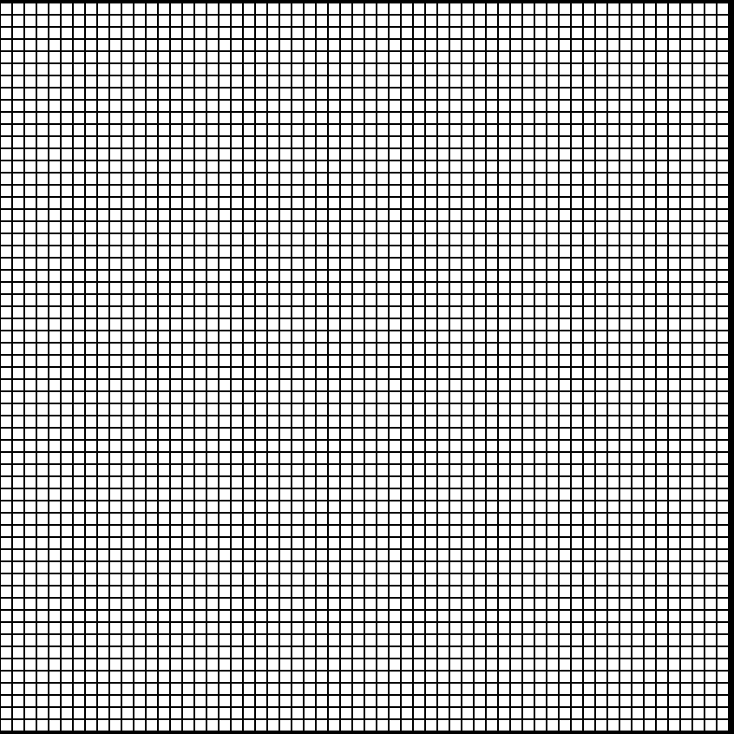
Scan Converting a Point
A pixel (10, 6)
Y
A point (-12.3, 10.3, 0)
X
X
Z
Y
MODELLING CO-ORDINATES
Mathematically vectors are defined in an infinite, “real-number” Cartesian co-ordinate system
SCREEN COORDINATES
a.k.a device co-ordinates, pixel co-ordinates
On display hardware we deal with finite, discrete coordinates
X, Y values in positive integers
0,0 is measured from top-left usually with +Y pointing down
Wednesday, February 16, 2022
Computer Graphics
1
Notes:
<number>

Slide 16
Scan Converting a Point
Each pixel on graphic display does not represent a mathematical point like P(2.6,3.33). But it can be accommodated to the nearest position by applying few mathematical functions such as
CEIL P ≈ (3,4)
FLOOR P ≈ (2,3)
GREATEST INTEGER FUNCTION P ≈ (3,3)
ROUND P ≈ (3,3)
Wednesday, February 16, 2022
Computer Graphics
1
Notes:
<number>

Slide 17
Scan Conversion Algorithms
Scan Conversion of Point
Scan Conversion of Line
Scan Conversion of Circle
Scan Conversion of Ellipse
Wednesday, February 16, 2022
Computer Graphics
1

Slide 18
How does computer draw line?
Screen made of pixels
High-level language specifies line
System must color pixels

Slide 19
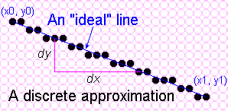
Towards the ideal Line
We can only do a discrete approximation
Illuminate pixels as close to the true path as possible, consider bi-level display only
Pixels are either lit or not lit
1

Slide 20
What is an ideal line?
Must appear straight and continuous
Only possible axis-aligned and 45º lines
Must interpolate both defining end points
Must have uniform density and intensity
Consistent within a line and over all lines
What about antialiasing?
Must be efficient, drawn quickly
Lots of them are required!!!
1

Slide 21
Line Drawing Algorithm
Programmer specifies (x,y) values of end pixels
Need algorithm to figure out which intermediate pixels are on line path
Pixel (x,y) values constrained to integer values
Actual computed intermediate line values may be floats
Rounding may be required. E.g. computed point
(10.48, 20.51) rounded to (10, 21)
Rounded pixel value is off actual line path (jaggy!!)
Sloped lines end up having jaggies
Vertical, horizontal lines, no jaggies

Slide 22
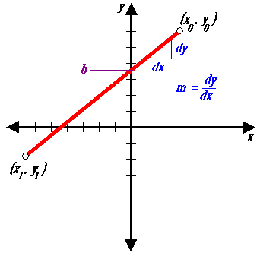
Simple Line
Based on slope-intercept algorithm from algebra:
y = mx + b ( (also Ax + By + C = 0)
Simple approach:
increment x, solve for y
Floating point arithmetic required
1

Slide 23
The Problem of Scan Conversion
A line segment in a scene is defined by the coordinate positions of the line end-points
y
(7, 5)
(2, 2)
x

Slide 24
The Problem of Scan Conversion
But what happens when we try to draw this on a pixel based display?
How do we choose which pixels to turn on?

Slide 25
Considerations
Considerations to keep in mind:
The line has to look good
Avoid jaggies
It has to be lightening fast!
How many lines need to be drawn in a typical scene?
This is going to come back to bite us again and again

Slide 26
Line Equations
Let’s quickly review the equations involved in drawing lines
Consider 2 end points (X_{0,}Y₀) and (X _{end}, Y _{end})
y
Slope-intercept line equation:
y_{end}
$y=m⋅x+b$
y₀
where:
$m=\frac{y_{\text{end}}−y_{0}}{x_{\text{end}}−x_{0}}$
x₀
x_{end}
x
$b=y_{0}−m⋅x_{0}$

Slide 27
For any given x intervals dx along a line, we can compute the corresponding y if interval dY from eqn
dy=m dx
Similarly, we can obtain the x interval dx corresponding to a specified dy as
dx = dy/m

Slide 28
A Very Simple Solution (cont…)
Slant Slope Case
Sharp Slope Case
IF M>1
IF M<1
7
7
6
6
5
5
4
4
3
3
2
2
1
1
0
0

Slide 29
Increment of x or y depends on slope
Sharp Slope Case:
If m>1, increment y and find x dy can be set propos ional to a small vertical deflection voltage and the corresponding horizontal deflection voltage set propos ional to dx as calculated from eqn.
Slant Slope Case:
If m<1, increment x and find y
dx can be set proposional to a small horizontal deflection voltage and the corresponding vertical deflection voltage set propos ional to dy as calculated from eqn
If m=1, dx=dy and horizontal and vertical deflections voltages are equal.

Slide 30
Lines & Slopes
The slope of a line (m) is defined by its start and end coordinates
The diagram below shows some examples of lines and their slopes
m = ∞
m = -4
m = 4
m = -2
m = 2
m = -1
m = 1
m = -¹/₂
m = ¹/₂
m = -¹/₃
m = ¹/₃
m = 0
m = 0

Slide 31
A Very Simple Solution
We could simply work out the corresponding y coordinate for each unit x coordinate
Let’s consider the following example:
y
(7, 5)
5
2
(2, 2)
2
7
x

Slide 32
A Very Simple Solution (cont…)
y
(7, 5)
LINE EQUATION : y= mx+b
First work out m and b:
5
$m=\frac{5−2}{7−2}=\frac{3}{5}$
2
(2, 2)
$b=2−\frac{3}{5}∗2=\frac{4}{5}$
2
3
4
5
6
7
x
Now for each x value work out the y value:
$y\left(3\right)=\frac{3}{5}⋅3+\frac{4}{5}=2\frac{3}{5}$
$y\left(4\right)=\frac{3}{5}⋅4+\frac{4}{5}=3\frac{1}{5}$
$y\left(5\right)=\frac{3}{5}⋅5+\frac{4}{5}=3\frac{4}{5}$
$y\left(6\right)=\frac{3}{5}⋅6+\frac{4}{5}=4\frac{2}{5}$

Slide 33
A Very Simple Solution (cont…)
Now just round off the results and turn on these pixels to draw our line
$y\left(3\right)=2\frac{3}{5}≈3$
7
6
5
$y\left(4\right)=3\frac{1}{5}≈3$
4
3
$y\left(5\right)=3\frac{4}{5}≈4$
2
1
0
$y\left(6\right)=4\frac{2}{5}≈4$
0
1
2
3
4
5
6
7
8

Slide 34
A Very Simple Solution (cont…)
However, this approach is just way too slow
In particular look out for:
The equation y = mx + b requires the multiplication of m by x
Rounding off the resulting y coordinates
We need a faster solution

Slide 35
A Quick Note About Slopes
In the previous example we chose to solve the parametric line equation to give us the y coordinate for each unit x coordinate
What if we had done it the other way around?
So this gives us:
where: and
$x=\frac{y−b}{m}$
$m=\frac{y_{\text{end}}−y_{0}}{x_{\text{end}}−x_{0}}$
$b=y_{0}−m⋅x_{0}$
If m>1, increment y and find x If m≤1, increment x and find y

Slide 36
A Quick Note About Slopes (cont…)
Leaving out the details this gives us:
We can see easily that this line doesn’t look very good!
We choose which way to work out the line pixels based on the slope of the line
$x\left(3\right)=3\frac{2}{3}≈4$
$x\left(4\right)=5\frac{1}{3}≈5$
7
6
5
4
3
2
1
0
0
1
2
3
4
5
6
7
8

Slide 37
A Quick Note About Slopes (cont…)
If the slope of a line is between -1 and 1 then we work out the y coordinates for a line based on it’s unit x coordinates
Otherwise we do the opposite – x coordinates are computed based on unit y coordinates
m = ∞
m = -4
m = 4
m = -2
m = 2
m = -1
m = 1
m = -¹/₂
m = ¹/₂
m = -¹/₃
m = ¹/₃
m = 0
m = 0

Slide 38
Issues with Line Drawing
Line drawing is such a fundamental algorithm that it must be done fast
Use of floating point calculations does not facilitate speed
Furthermore, lines must be drawn without gaps
Gaps look bad
If you try to fill a polygon made of lines with gaps the fill will leak out into other portions of the display
Eliminating gaps through direct implementation of any of the standard line equations is difficult
Finally, we don’t want to draw individual points more than once
That’s wasting valuable time

Slide 39
DDA Algorithm
DDA = Digital Differential Analyser
Finite differences
Start with starting and ending coordinates of the line:
(x0, y0) and (x1, y1)
Color first pixel (round to nearest integer)
Suppose x1-x0 > y1-y0 (gentle slope)
There will be x1-x0 steps (# pixels to be colored)
Set x=x0, y=y0
At each step,
increment x by (x1-x0)/numsteps, and
increment y by (y1-y0)/numsteps
For each step, round off x and y to nearest integer, and color pixel

Slide 40
Calculating the Values of ‘x’ and ‘y’
Step 1: For lines whose slope is positive and is less than or equal to 1 (m≤1)
These lines can be sampled at ‘x’ intervals i.e., x = 1 and the corresponding ‘y’ values can be calculated using,
Y_{k+1} = Y_{k}+ m
Where, ‘k’ takes the integer values starting from 1 and its value is successfully incremented, till the last point is reached and the slope ‘m’ can either ‘0’ or’1’.
Step 2: For lines whose slope is positive and is greater than 1 (m>1)
These lines can be sampled at unit ‘y’ intervals i.e., y = 1 and the corresponding ‘x’ values can be determined as,
x_{k+1} = x_{k} / m
Line processing starts from left to right. If the first end point is at right then.
y_{k+1} = y_{k} - m and x_{k+1} = x_{k} / m

Slide 41
DDA algorithm
Step 1: Read the 2 end points (x1,y1), (x2,y2)
Step 2: Horizontal and vertical differences between the end points positions are assigned to parameters dx and dy.
dx=x2-x1
dy=y2-y1
Step 3: The difference with the greater magnitude determines the value of parameter steps
If (abs(dx)> abs(dy)) then
steps = abs(dx) // Slant slope case
Else
steps = abs(dy) // Sharp slope case
Step 4: Starting with pixel positions (x1,y1) and we determine the offset needed at each step to generate the next pixel position along the line path.
X_{increment} = dx/ steps
Y_{increment} = dy/ steps
Step 5: Assign the values of x1, y1 to x,y respectively
x=x1 y=y1
Step 6: Plot the point at (x,y) positions on screen set pixel (round(x),round(y),1). Here 1 is the intensity of pixel i.e, intensity with which picture illuminated.
Step 7: Calculate the values of x and y for next pixel position
X= x+Xincrement
Y= y+ Yincrement
Step 8: Plot the pixel at (x,y) position, set pixel(round(x),round(y),1).
Step 9: repeat the steps 7 and 8 until steps=0.

Slide 42
DDA Pseudo-code
// assume that slope is gentle
DDA(float x0, float x1, float y0, float y1) {
float x, y;
int dx = x1-x0, dy = y1-y0;
int numsteps = max(abs(dx),abs(dy));
float xinc, yinc;
xinc = dx / numsteps;
yinc = dy / numsteps;
x = x0;
y = y0;
ColorPixel(Round(x),Round(y));
for (int i=0; i<numsteps; i++) {
x += xinc;
y += yinc;
ColorPixel(Round(x),Round(y));
}
}
Q: For each step, how many floating point operations are there?
A: 2
Q: For each step, how many integer operations are there?
A: 2

Slide 43
DDA Example
dx = 12 – 2 = 10, dy = 8-3 =5
numsteps = max(abs(dx),abs(dy)=max(10,5)=10
xinc = dx/numsteps = 10/10 = 1.0
yinc = dy/numsteps = 5/10 = 0.5
Suppose we want to draw a line starting at pixel (2,3) and ending at pixel (12,8).
What are the values of the variables x and y at each timestep?
What are the pixels colored, according to the DDA algorithm?
t | x | y | R(x) | R(y)
0 | 2 | 3 | 2 | 3
1 | 3 | 3.5 | 3 | 4
2 | 4 | 4 | 4 | 4
3 | 5 | 4.5 | 5 | 5
4 | 6 | 5 | 6 | 5
5 | 7 | 5.5 | 7 | 6
6 | 8 | 6 | 8 | 6
7 | 9 | 6.5 | 9 | 7
8 | 10 | 7 | 10 | 7
9 | 11 | 7.5 | 11 | 8
10 | 12 | 8 | 12 | 8

Slide 44
10
9
8
7
6
5
4
3
2
1
0
P(x) | P(y)
2 | 3
3 | 4
4 | 4
5 | 5
6 | 5
7 | 6
8 | 6
9 | 7
10 | 7
11 | 8
12 | 8
0 1 2 3 4 5 6 7 8 9 10 11 12 13

Slide 45
DDA Example
Suppose we want to draw a line starting at pixel (1,2) and ending at pixel (5,5).
What are the values of the variables x and y at each timestep?
What are the pixels colored, according to the DDA algorithm?
t | x=x+xinc | y=y+yinc | R(x) | R(y)

Slide 46
DDA Example
dx = 5 – 1 = 4, dy = 5-2 =3
numsteps = max(abs(dx),abs(dy)=max(4,3)=4
xinc = dx/numsteps = 4/4 = 1.0
yinc = dy/numsteps = 3/4 = 0.75
Suppose we want to draw a line starting at pixel (1,2) and ending at pixel (5,5).
What are the values of the variables x and y at each timestep?
What are the pixels colored, according to the DDA algorithm?
t | x=x+xinc | y=y+yinc | R(x) | R(y)
0 | 1 | 2 | 1 | 2
1 | 2 | 2.75 | 2 | 3
2 | 3 | 3.5 | 3 | 4
3 | 4 | 4.25 | 4 | 4
4 | 5 | 5 | 5 | 5

Slide 47
DDA Example
Suppose we want to draw a line starting at pixel (2,1) and ending at pixel (6,9).
What are the values of the variables x and y at each timestep?
What are the pixels colored, according to the DDA algorithm?
t | x=x+xinc | y=y+yinc | R(x) | R(y)

Slide 48
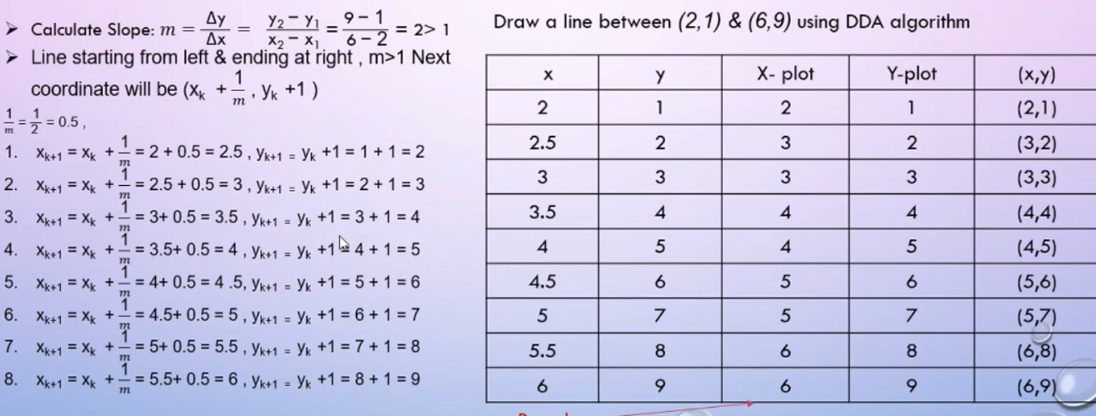

Slide 49
DDA Algorithm (continued)
Y_inc
X_inc
… but floating point operations and rounding operations are expensive

Slide 50
DDA Algorithm (continued)
Still need a lot of floating point arithmetic.
2 ‘round’s and 2 adds per pixel.
Is there a simpler way ?
Can we use only integer arithmetic ?
Easier to implement in hardware.

Slide 51
Advantages of DDA
It calculates the pixel positions faster than the calculations performed by using the equation y=mx +b.
Multiplication is eliminated as the x and y increments are used to determine the position of the next pixel on a line

Slide 52
Disadvantages of DDA
The rounding and floating point operations are time consuming.
The round-off error which results in each successive addition leads to the drift in pixel position, already calculated

Slide 53
The DDA Algorithm Summary
The DDA algorithm is much faster than our previous attempt
In particular, there are no longer any multiplications involved
However, there are still two big issues:
Accumulation of round-off errors can make the pixelated line drift away from what was intended
The rounding operations and floating point arithmetic involved are time consuming

Slide 54
Conclusion
Drawing lines to pixel based displays is time consuming so we need good ways to do it
The DDA algorithm is pretty good – but we can do better
Next time we’ll look at the Bresenham’s line algorithm and how to draw circles, fill polygons and anti-aliasing

Slide 55
Bresenham’s Line Drawing Algorithm
Jack Bresenham addressed these issues with the Bresenham Line Scan Convert algorithm
This was back in 1965 in the days of pen-plotters
All simple integer calculations
Addition, subtraction, multiplication by 2 (shifts)
Guarantees connected (gap-less) lines where each point is drawn exactly 1 time
Also known as the midpoint line algorithm

Slide 56
Bresenham’s Algorithm
Uses only integer calculations
Uses distance between ideal y-coordinate and the upper and lower pixel (assuming gentle slope)
y_{k+1}
y_{k+1}
d_{upper}
y
d_{lower}
y_{k}
x_{k+1}

Slide 57
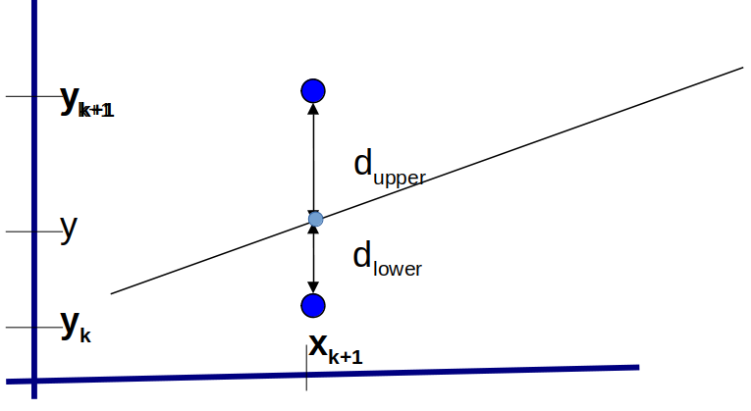
Bresenham’s Algorithm
y = m(x_{k + 1}) + b
d_{lower} = y − y _{k} = m(x_{k + 1}) + b − y_{k}
d _{upper} = (y _{k + 1}) − y = y _{k + 1} − m(x _{k + 1}) − b

Slide 58
Bresenham’s Algorithm
d _{lower} − d _{upper} = 2m(x _{k + 1}) − 2y _{k} + 2b − 1
m = dx/dy
p_{k} = dx(d _{lower} − d _{upper} )
= 2dy x_{k} – 2dx y_{k} + c
where c = 2dy + dx(2b − 1)

Slide 59
Bresenham’s Line Algorithm
What it comes down to is computing how close the midpoint (between the two grid points) is to the actual line
(x_{p}, y_{p})
(x_{p}+1, y_{p}+½)

Slide 60
Bresenham’s Line Algorithm
Define F(m) = F(Mx, My) = d as the discriminant
(derive from the equation of a line Ax + By + C)
if (d_{m} > 0) choose the upper point (pixel), otherwise
if (d_{m} <0), i.e, negative then choose the lower point (pixel)
Decision parameter d_{m} is referred in book as Pk
$\begin{aligned}F\left(m\right)=d_{m}=F\left(x_{p}+1,y_{p}+\frac{1}{2}\right) \\ F\left(m\right)=d_{m}=A⋅\left(x_{p}+1\right)+B⋅\left(y_{p}+\frac{1}{2}\right)+C\end{aligned}$

Slide 61
Bresenham’s Line-Drawing Algorithm
(x_{k+1},y_{k+1})
(x1,y1)
What Pixels to turn on or off?
Consider pixel midpoint M(Mx, My)
M = (x0 + 1, Y0 + ½)
If P_{k} < 0, M lies above line,
shade lower pixel (E pixel)
the next point to plot is (x _{k} + 1, y _{k} )
M(Mx,My)
If P_{k} > 0, M lies below line,
shade upper pixel(same y as before),
Also caled NE pixel
the next point to plot is (x _{k + 1}, y _{k + 1})
…
(x0, y0)
(x_{k},y_{k})

Slide 62
General idea how Bresenham works
Suppose that the line is gently sloping upwards from left to right.
Start by coloring the left-most pixel.
Then, for the next column (that is, for each x value), we have to figure out whether we color the same y or y+1.
How do we decide?
When going from one column to the next, add an error value. If the error value is more than 0.5, we should color y+1 and reset the error value. Otherwise, color y and accumulate the error value.
However, it seems like we’re still using floating point
Solution, multiply both sides by 2 so that we use integer comparisons instead.

Slide 63
Bresenham’s Algorithm
Input the two line endpoints and store left endpoint as (x₀,y₀)
Color/Plot pixel (x₀,y₀), plot the first point
Pre-calculate the values dx, dy, 2dy and 2dy – 2dx
Let p0 = 2dy – dx
At each xk along the line, starting with k=0:
5. Repeat Step-4 dx-1 more times
If pk<0, then the next point to plot is (xk + 1,yk),
and pk+1 = pk + 2dy
Else, the next point to plot is (xk + 1, yk + 1),
and pk+1 = pk + 2dy – 2dx
Switch Point 0 and Point 1 if necessary
If negative slope, reflect
If steep slope, flip y and x

Slide 64
Number of Operations in Bresenham’s Algorithm
Q: In each step, how many floating point operations are there?
A: 0
Q: In each step, how many integer operations are there?
A: 3 or 4

Slide 65
Bresenham’s Algorithm Example
dx =
dy =
P0 = 2dy – dx
If Pk<0, pk+1 = pk + 2dy
p k < 0, the next point to plot is (x _{k + 1}, y _{k})
else pk+1 = pk + 2dy-2dx
the next point to plot is (x _{k + 1}, y _{k + 1})
2dy =
2dy – 2dx =
Suppose we want to
draw a line starting at pixel (20,10) and ending at pixel (30,18).
What are the values of p0, dx and dy?
What are the values of the variable p at each timestep?
What are the pixels colored, according to Bresenham’s algorithm?
t | p | P(x) | P(y)

Slide 66
Bresenham’s Algorithm Example
dx = 30 – 20 = 10
dy = 18 – 10 = 8
p0 = 2dy – dx = 16-10= 6
If Pk<0, pk+1 = pk + 2dy else pk+1 = pk + 2dy-2dx
2dy = 2x8=16
2dy – 2dx = -4
Suppose we want to draw a line starting at pixel (20,10) and ending at pixel (30,18).
This line has a slope of 0.8, wit
We plot the initial point
(x ₀ , y ₀ ) = (20, 10)
What are the pixels colored, according to Bresenham’s algorithm?
t | p | P(x) | P(y)
0 | 6 | 21 | 11
1 | 2 | 22 | 12
2 | -2 | 23 | 12
3 | 14 | 24 | 13
4 | 10 | 25 | 14
5 | 6 | 26 | 15
6 | 2 | 27 | 16
7 | -2 | 28 | 16
8 | 14 | 29 | 17
9 | 10 | 30 | 18

Slide 67
Bresenham’s Algorithm Example
dx = 12 – 2 = 10
dy = 8 – 3 = 5
p0 = 2dy – dx = 10-10= 0
If Pk<0, pk+1 = pk + 2dy else pk+1 = pk + 2dy-2dx
2dy = 10
2dy – 2dx = -10
Suppose we want to draw a line starting at pixel (2,3) and ending at pixel (12,8).
What are the values of p0, dx and dy?
What are the values of the variable p at each timestep?
What are the pixels colored, according to Bresenham’s algorithm?
t | p | P(x) | P(y)
0 | 0 | 2 | 3
1 | -10 | 3 | 4
2 | 0 | 4 | 4
3 | -10 | 5 | 5
4 | 0 | 6 | 5
5 | -10 | 7 | 6
6 | 0 | 8 | 6
7 | -10 | 9 | 7
8 | 0 | 10 | 7
9 | -10 | 11 | 8
10 | 0 | 12 | 8

Slide 68
10
9
8
7
6
5
4
3
2
1
0
P(x) | P(y)
2 | 3
3 | 4
4 | 4
5 | 5
6 | 5
7 | 6
8 | 6
9 | 7
10 | 7
11 | 8
12 | 8
0 1 2 3 4 5 6 7 8 9 10 11 12 13

Slide 69
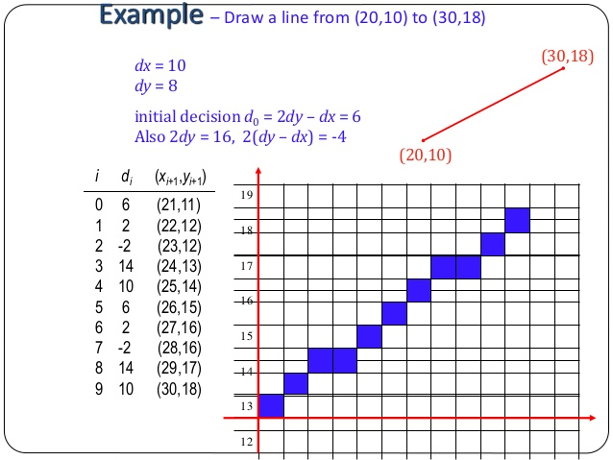

Slide 70
Summary of mid-point algorithm
Choose between 2 pixels at each step based upon the sign of a decision variable.
Update the decision variable based upon which pixel is chosen.
Start point is simply first endpoint (x1,y1).
Need to calculate the initial value for Pk
1

Slide 71
Summary of line drawing so far.
Explicit form of line
Inefficient, difficult to control.
Parametric form of line.
Express line in terms of parameter t
DDA algorithm
Implicit form of line
Only need to test for ‘side’ of line.
Bresenham algorithm.
Can also draw circles.
1

Slide 72
Problems with Bresenham algorithm
Pixels are drawn as a single line ⇒ unequal line intensity with change in angle.
Pixel density = √2.n pixels/mm
Can draw lines in darker colours according to line direction.
Better solution : antialiasing !
(eg. Gupta-Sproull algorithm)
Pixel density = n pixels/mm
1

